Slide 1
Clean code in CSS

Slide 2
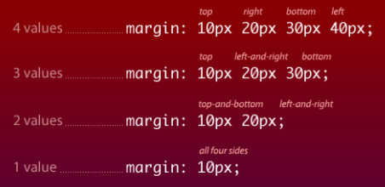
Use Shorthand
CSS Shorthand means that instead of using different declarations for related properties you may use shorthand properties to combine those values By specifying a different number of values

Slide 3
Use whitespace wisely
Whitespace, including spaces, tabs, and extra line breaks, is important for readability for CSS code
Using whitespace effectively is great, and a recommended practice for easy-to-manage code, but be aware that the less whitespace you have, the smaller the file.

Slide 4
Prune frameworks and resets
Using a framework and/or a reset set of rules can help keep your work optimized, but they should not be accepted in their default state. Considering each declaration and cutting back on unneccessary ones can further help you keep your CSS files lean and readable.

Slide 5
Separate your code
Another way to optimize your code is to separate layout-specific declarations from the rest of your rules and giving layout it’s own file, or at least it’s own section

Slide 6
Avoid Global Selectors
- Global selectors include
1- the universal selector (*)
2- element selectors such as p, button, and h1,
3- attribute selectors such as [type=checkbox].
- Style declarations applied to these selectors will be applied to every such element across the site
- Global styles and selectors are perfectly okay for resetting and normalizing default browser styles.

Slide 7
Avoid Using id Selectors
Because you can only have one element per id per document, rule sets that use id selectors are hard to repurpose

Slide 8
Use Semantic Class Names
Class names should describe what the rule does or the type of content it affects

